Slide 1
Sedimentary Rocks

Slide 2
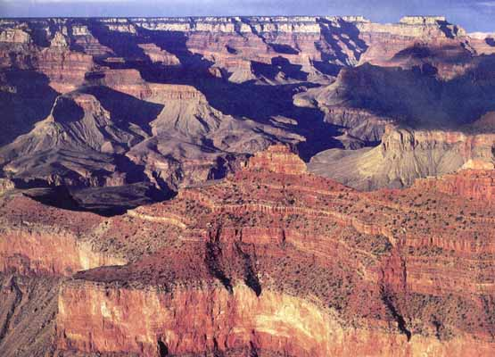
Sedimentary Rocks: rock formed when sediments become pressed or cemented together
COPY ME

Slide 3
COPY ME
Sediments: loose materials such as rock fragments and mineral grains that have been transported by wind, water, or glacier
Weathering: the breaking of rocks into smaller pieces, either mechanically or chemically
Erosion: the process that moves weathered rocks from one location to another
Deposition: the buildup of sediments on the bottoms of lakes, valleys and the ocean floor usually in layers

Slide 4
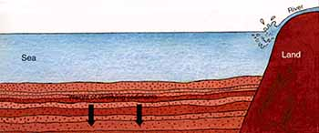
COPY ME
Compaction: is when sediment becomes compressed by the weight of layers above them
Cementation: is when sediments are glued together by minerals deposited between the sediments

Slide 5
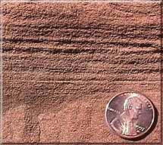
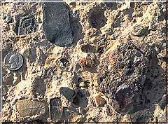
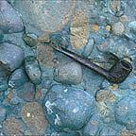
Three types of Sedimentary Rocks:
COPY ME
Clastic Sedimentary Rock: made of broken fragments of plants, animals, and primarily other rocks

Slide 6
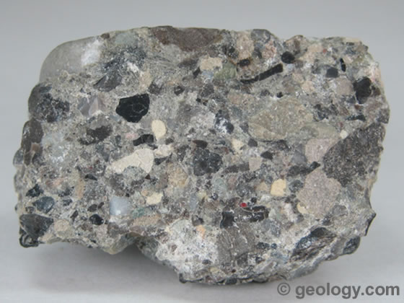
Examples of Clastic Sedimentary Rocks
Conglomerate- composed of rounded, pebble-sized fragments that are held together by a cement

Slide 7
Examples of Clastic Sedimentary Rocks
Breccia - composed of angular, pebble-sized fragments that are held together by a cement

Slide 8
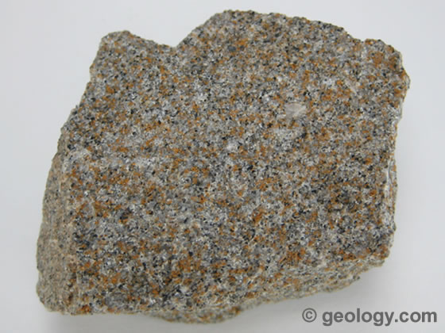
Examples of Clastic Sedimentary Rocks
Sandstone – composed of small mineral grains (usually quartz) that are cemented together.

Slide 9
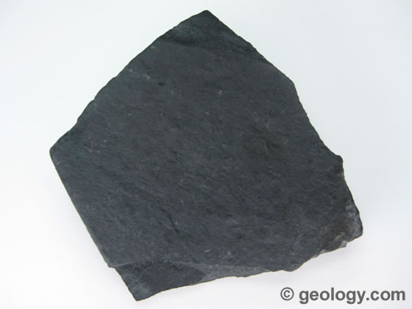
Examples of Clastic Sedimentary Rocks
Shale – made of flaky clay particles that compress into flat layers

Slide 10
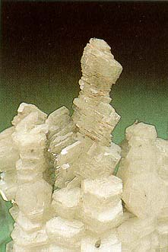
Chemical Sedimentary Rocks
COPY ME
made from minerals precipitated from a solution or are left behind when a solution evaporates –
minerals left behind from rocks are evaporites
Rock salt (halite) →

Slide 11
Organic Sedimentary Rock
COPY ME
primarily made from the remains of once living things

Slide 12
Examples of Organic Sedimentary Rock
Limestone
Fossiliferous Limestone
Chalk

Slide 13
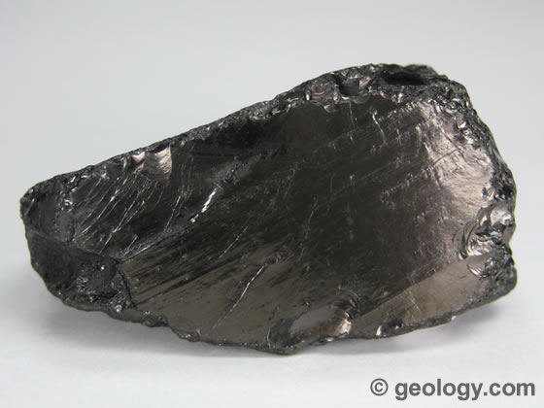
Example of Organic Sedimentary Rock
Coal - forms from plant remains that are buried before they decay. The plant layers are then compacted into matter that is composed mostly of carbon

Slide 15
Igneous Rocks

Slide 16
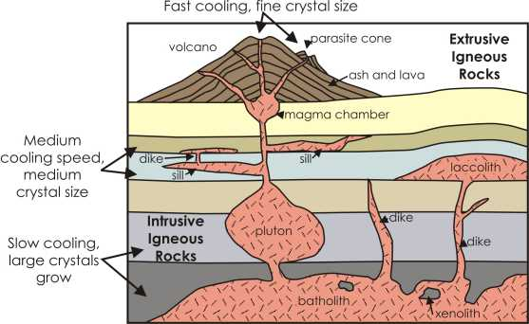
Igneous Rocks: rock formed when magma or lava cools

Slide 17
Lava: molten rock from a volcano flowing on Earth’s surface
Magma: molten rock beneath Earth’s surface
Intrusive: igneous rocks that form below Earth’s surface (plutonic)
Extrusive: igneous rocks that form when magma extrudes onto Earth’s surface and cools as lava (volcanic)

Slide 18
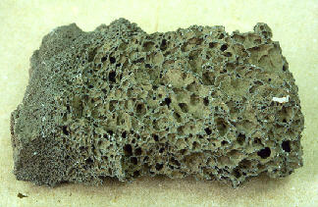
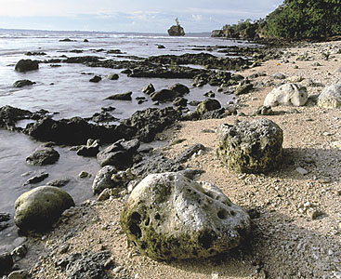
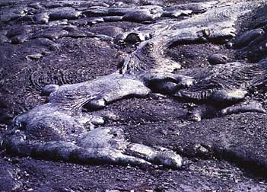
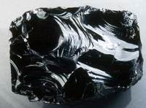
Above ground = from lava (extrusive igneous rock)
Usually have SMALL or NO crystals (they cooled too quickly)

Slide 20
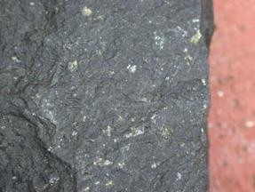
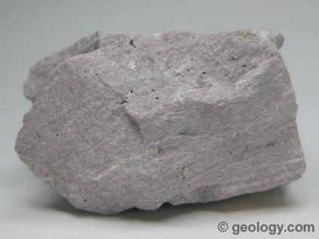
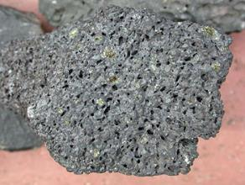
V. Igneous Rocks (cont)
Extrusive Examples
Basalt
Rhyolite
Vesicular Basalt

Slide 21
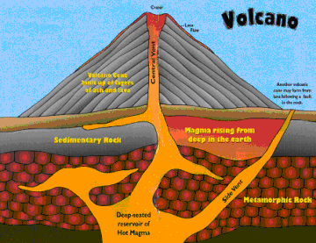
V. Igneous Rocks (cont)
Intrusive (Plutonic) – forms below surface (inside)
Slow Cooling
Large Crystals
Coarse Texture

Slide 22
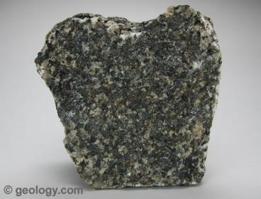
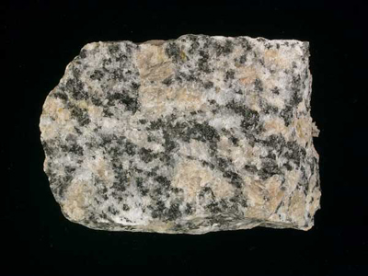
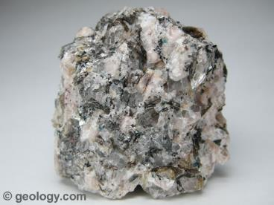
V. Igneous Rocks (cont)
Intrusive Examples
Gabbro
Pegmatite
Granite

Slide 23
V. Igneous Rocks (cont)
Naming Igneous Rocks – based on composition, texture, color and density

Slide 24
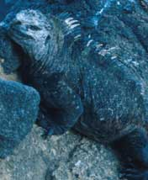
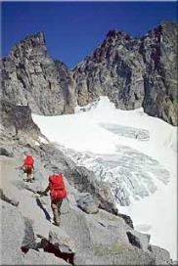
Igneous Rocks
Basaltic or Mafic: dark-colored igneous rocks that form from magma rich in iron & magnesium (high ferromagnesium minerals; low silica)
Granitic or Felsic: light-colored igneous rocks, form from magma rich in silicon and oxygen (low ferromagnesium minerals; high silica)

Slide 25
Igneous Rock Textures
A rock’s texture depends on the
- size,
- shape, and
- arrangement of crystals
A crystal’s size and shape depends:
- rate of cooling
- amount of dissolved gasses

Slide 26
SAMPLE PROBLEM.
Draw a line to illustrate the relationship between crystal size and rate of cooling in igneous rock formation.
crystal size
cooling time

Slide 27
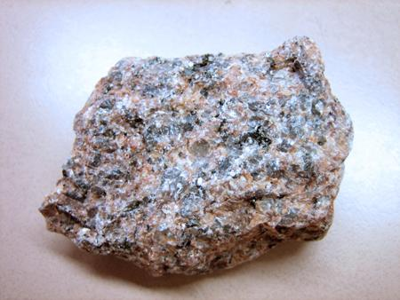
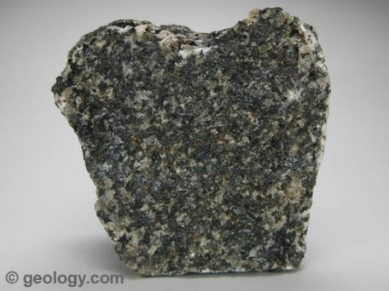
Coarse Grained
Mineral grains large enough to be seen with the unaided eye (Phaneritic):
Granite or Gabbro

Slide 28
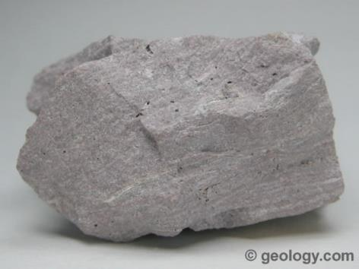
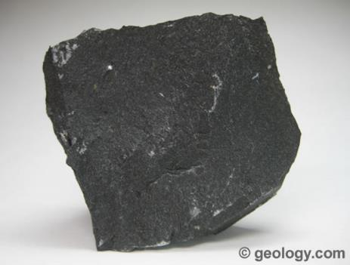
Fine Grained
Mineral grains too small to be seen with the unaided eye (Aphanitic):
For example: Rhyolite or Basalt

Slide 29
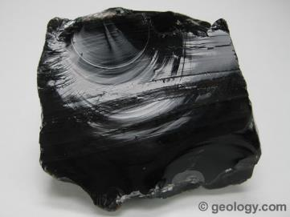
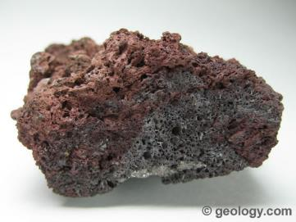
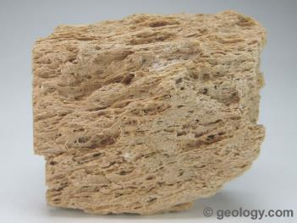
Glassy
Cooled so quickly that no crystals were able to be formed
Obsidian Scoria
or Pumice

Slide 30
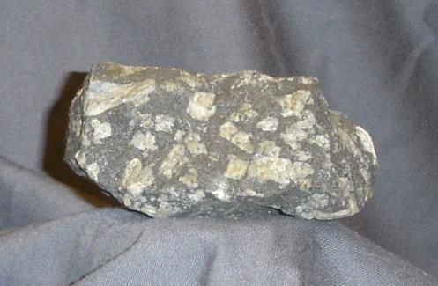
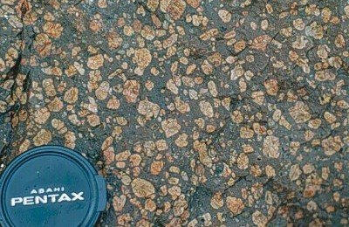
Porphyritic Texture
Displays two stages of cooling… slow and then fast (or quenched)

Slide 31
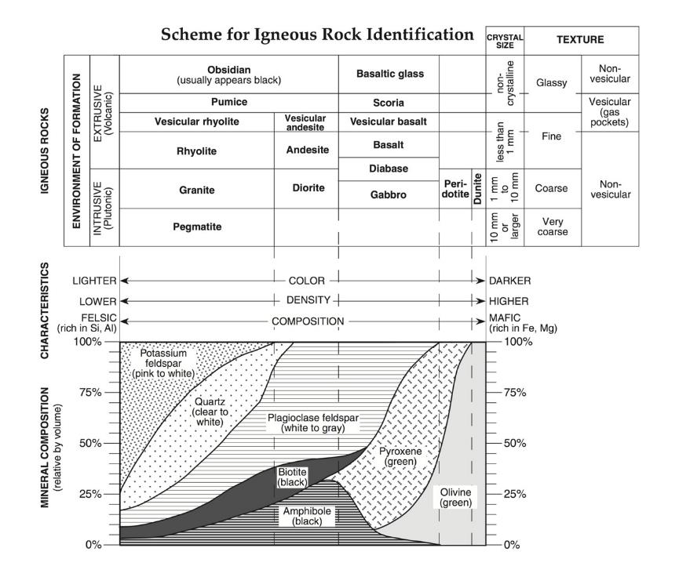

Slide 32
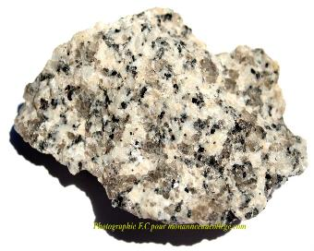
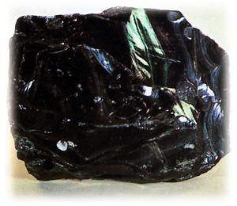
Granite: Intrusive or Extrusive? Why?
SAMPLE PROBLEMS.
Obsidian: Intrusive or Extrusive? Why?

Slide 33
Metamorphic Rock

Slide 34
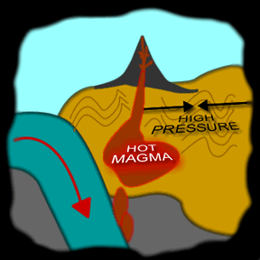
Metamorphic Rock: rock formed from existing rock when the temperature or pressure changes

Slide 35
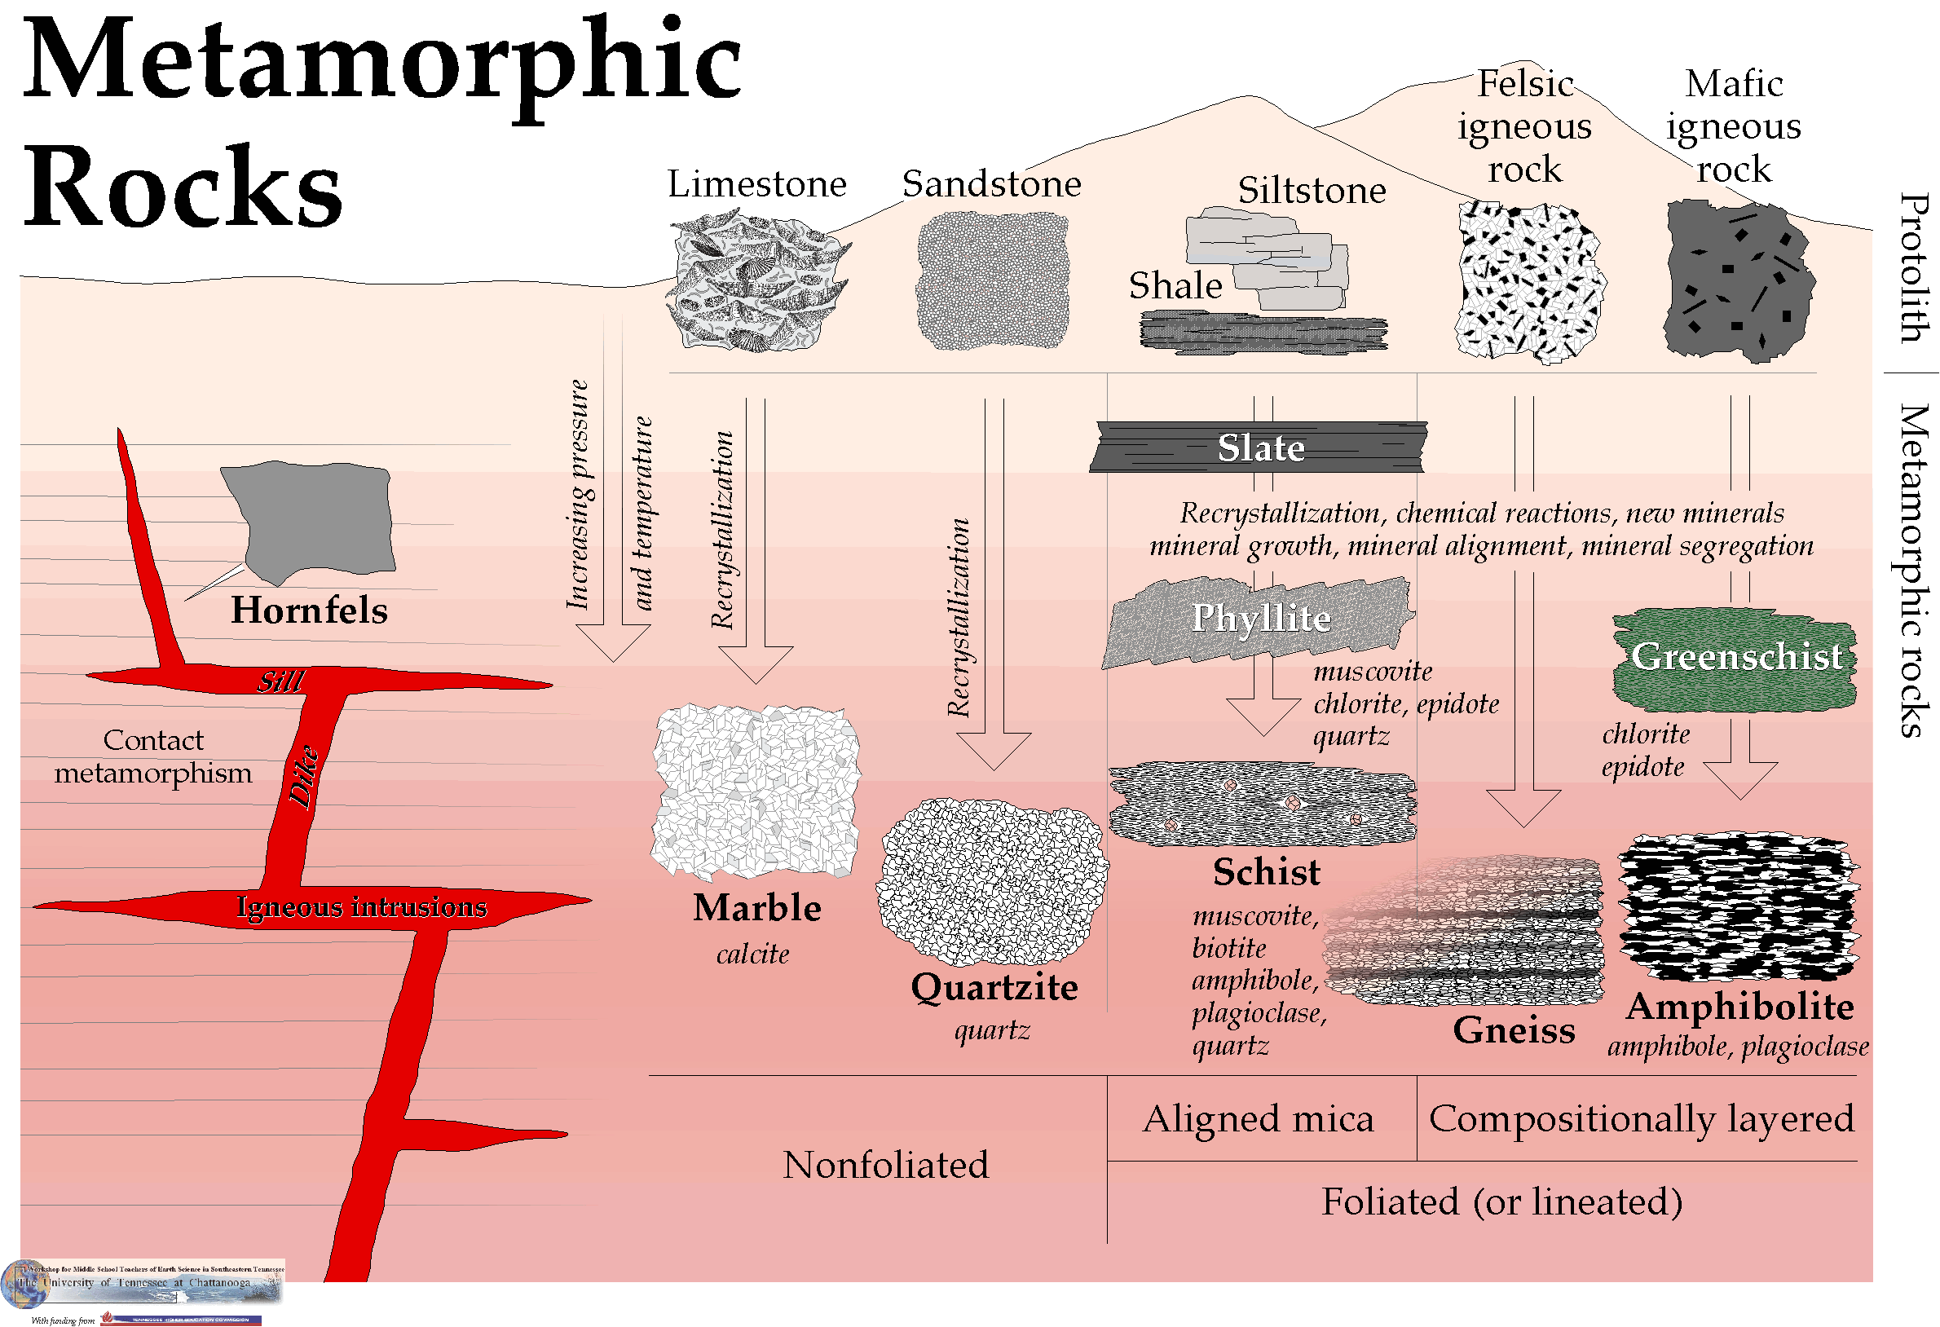

Slide 36
Textures of Metamorphic Rocks
Foliated: a texture of metamorphic rock, created when mineral grains flatten and line up in parallel bands
Nonfoliated: texture of metamorphic rock, created when mineral grains change, grow, & rearrange but don’t form bands

Slide 37
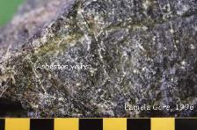
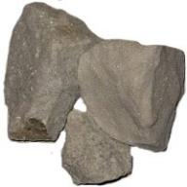
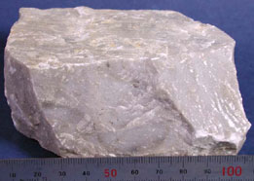
How are metamorphic rocks classified?
Non-Foliated—No bands are formed
Example: marble formed from limestone

Slide 38
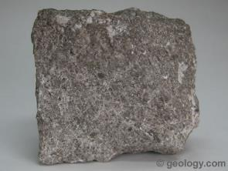
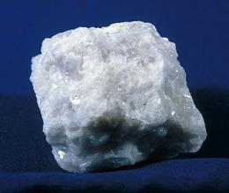
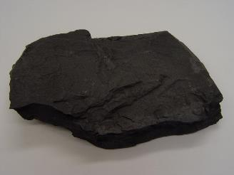
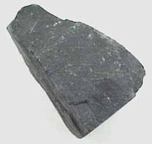
Rocks Transformed
Limestone
Marble
Shale
Slate

Slide 39
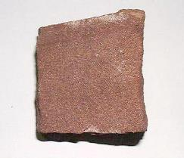
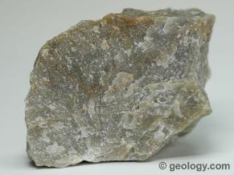
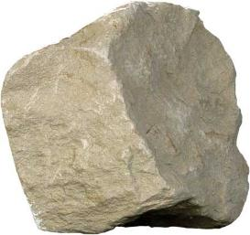
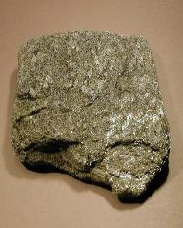
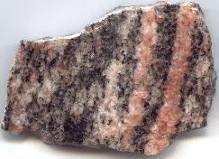
Rocks Transformed
Sandstone
Quartzite
Gneiss
Mudstone
Schist
or

Slide 40
Local Metamorphism
metamorphism that affects relatively small volumes of rock (less than 100 km³)

Slide 41
Regional Metamorphism
metamorphism that affects thousands of (km³) cubic kilometers of rock

Slide 42
Contact Metamorphism
metamorphism where temperature is the primary agent
Limestone
Marble
Basalt
Marble
Limestone
http://academic.brooklyn.cuny.edu/geology/grocha/monument/images/metheat.gif

Slide 43
Dynamic Metamorphism
metamorphism where pressure is the primary agent (aka deformational metamorphism)
http://www.indiana.edu/~g103/G103/wk5/week5.htm

Slide 44
Result of Dynamic Metamorphism

Slide 45
http://www.indiana.edu/~g103/G103/wk5/week5.htm

Slide 46
Examples of Metamorphic Rocks
Gneiss – metamorphosed granite, displays foliation and banding; a result of high grade metamorphism
(foliated texture)
kinked gneiss →

Slide 47
Examples of Metamorphic Rocks
Slate – pressure exerted on shale (claystone/
mudstone)
Schist – high heat and pressure exerted on slate
(both with foliated texture)
http://library.thinkquest.org/05aug/00461/images/slate.jpg
http://www.windows.ucar.edu/tour/link=/earth/geology/images/Schist_mica_jpg_image.html

